Slide 1


Phishing Sites Detection
19DCE004 : Archan Bhalani
19DCE066 : Dhruv Maradiya
19DCE075 : Femil Mori
Guided by:
Shraddha Vyas

Slide 2
Contents
Project Theory
Proposed Approach
Requirement gathering and Technique used.
Hardware and software requirement
Flowchart
Screen Shots
Results of algorithm
Limitation and future scope
References

Slide 3
Project Theory
Phishing or Phishing attack is a type of social engineering attack carried out by the online criminals who send out fraudulent communications to users to steal their personal details, such as login credentials, bank account details, and debit or credit card numbers. The Phishing attacker masquerades as a trusted entity tricks their victims into opening a fraudulent email, instant message, or text message that appear to be coming from a reputable source.
The receiver is then duped into clicking a malicious link, which can lead to the installation of malware. The malicious software freezes the computer as a part of ransomware attack or fakes them to disclose the sensitive data message that appear to be coming from a reputable source.

Slide 4
Types of Phishing attack
Deceptive phishing
Deceptive phishing is the most common type of phishing. In this case, an attacker attempts to obtain confidential information from the victims. Attackers use the information to steal money or to launch other attacks. A fake email from a bank asking you to click a link and verify your account details is an example of deceptive phishing.
Spear phishing
Spear phishing targets specific individuals instead of a wide group of people. Attackers often research their victims on social media and other sites. That way, they can customize their communications and appear more authentic. Spear phishing is often the first step used to penetrate a company’s defenses and carry out a targeted attack.
Whaling
When attackers go after a “big fish” like a CEO, it’s called whaling. These attackers often spend considerable time profiling the target to find the opportune moment and means of stealing login credentials. Whaling is of particular concern because high-level executives are able to access a great deal of company information.

Slide 5
How does it works ?
Phishing is the method by which fraudulent information is sent to victims which appears to arrive from the legitimate sources. Mostly, the attackers chosen mode of delivering the infection is through email because it is more effective. The purpose is to rob the user of their sensitive data like credit card and login information or to install malware on the victim’s machine.
Phishing starts with a fraudulent email or other communication that is designed to lure a victim. The message is made to look as though it comes from a trusted sender. If it fools the victim, he or she is coaxed into providing confidential information, often on a scam website. Sometimes malware is also downloaded onto the target’s computer.

Slide 6

Requirement Gathering and technique used
Target Label
Phishing site
Not Phishing Site
Classifier
Training links
Testing links

Slide 7

Flowchart and Approach
Collection of Data
Split the Data Into Train and Test set
Build The Model
Train the Model
Results
Deploy The Model
Import Links To Prediction

Slide 8
Hardware and Software requirements
Python libraries
Kaggle dataset
Google collab
Node js

Slide 9
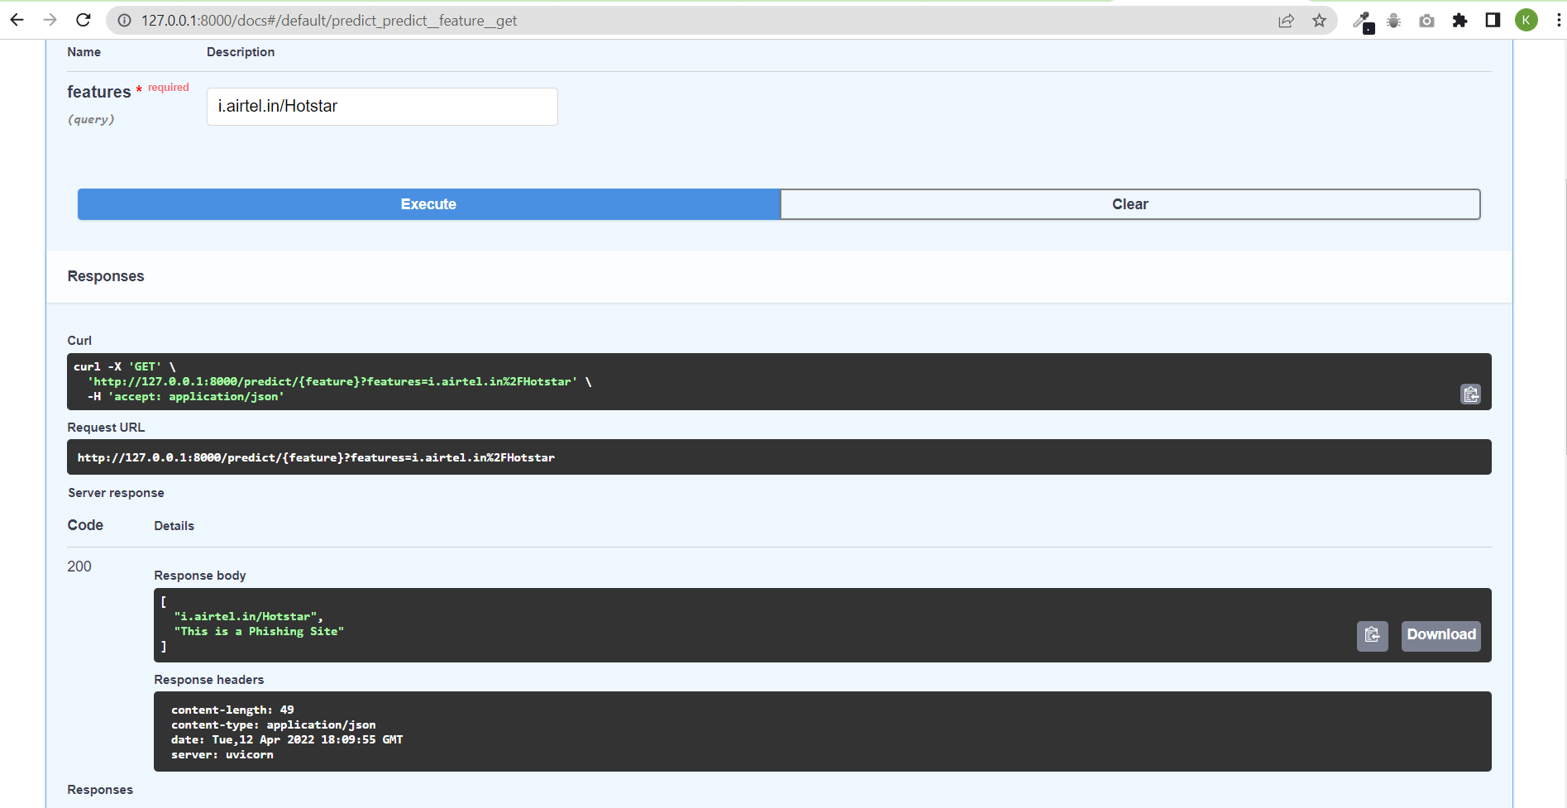
Screen Shots

Slide 10
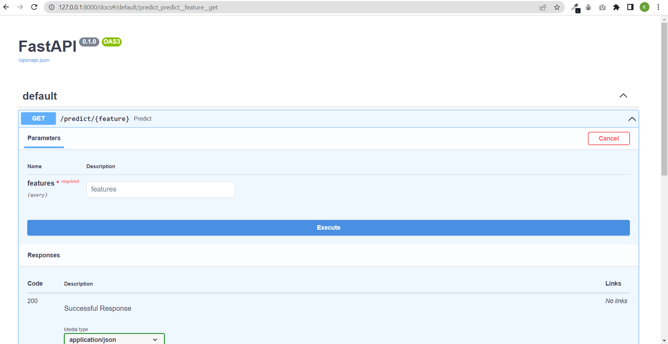

Slide 11
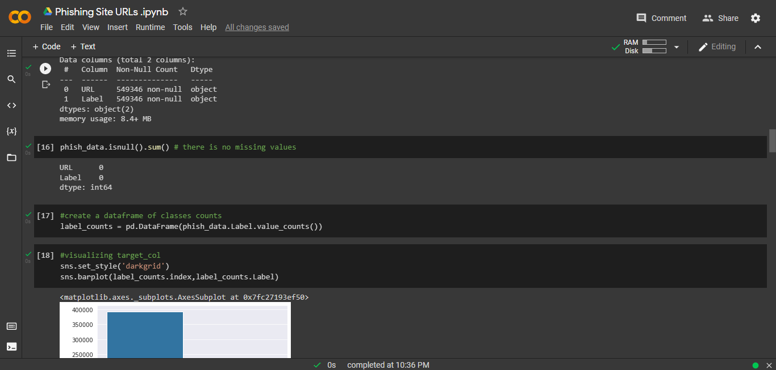

Slide 12
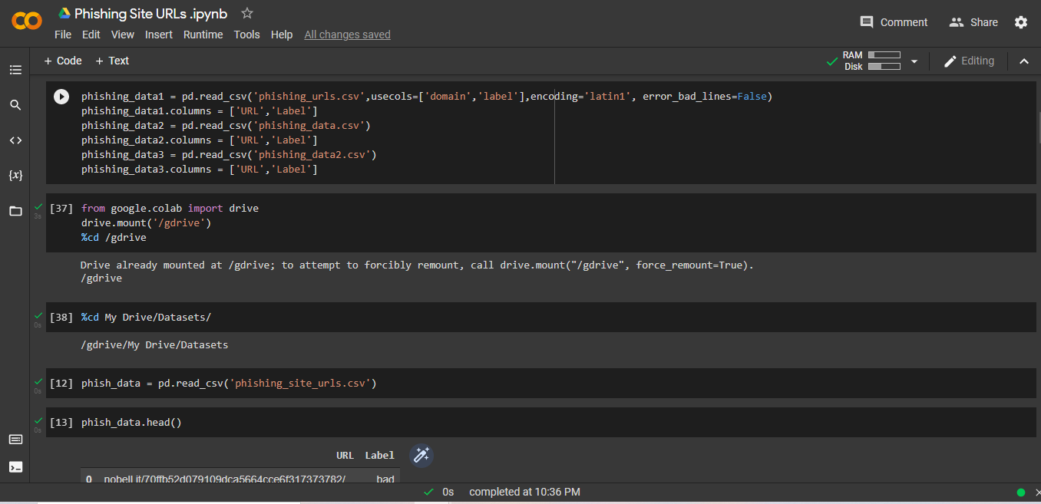

Slide 13
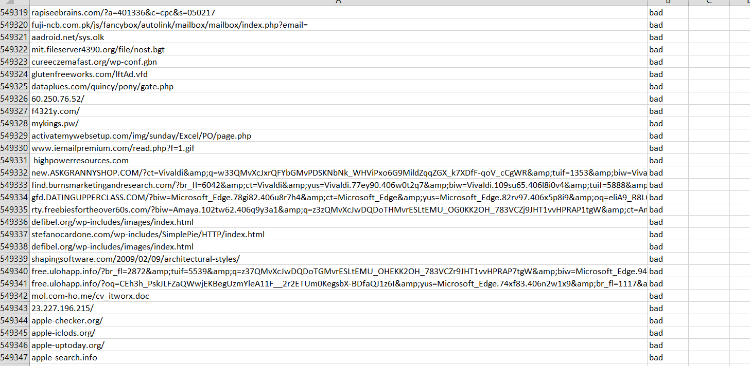
➔Datasets(549346)

Slide 14
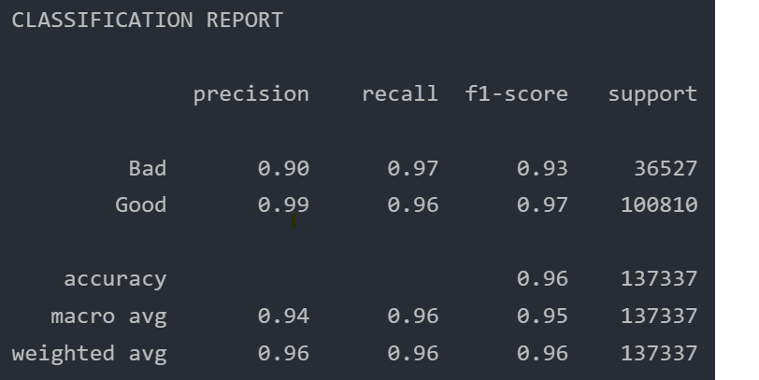
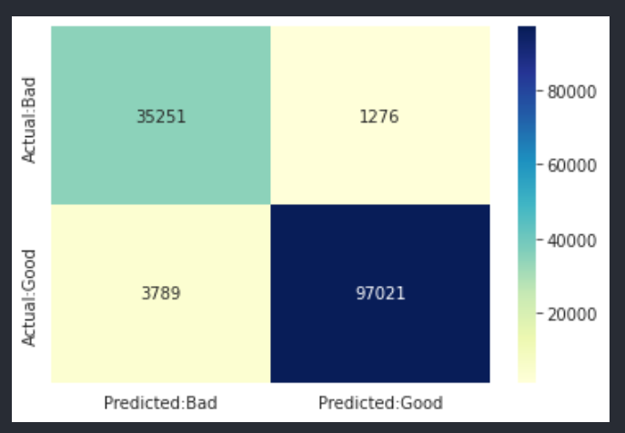
➔Logistic Regression results
Training Accuracy : 0.9778402898965799
Testing Accuracy : 0.9631199167012531

Slide 15
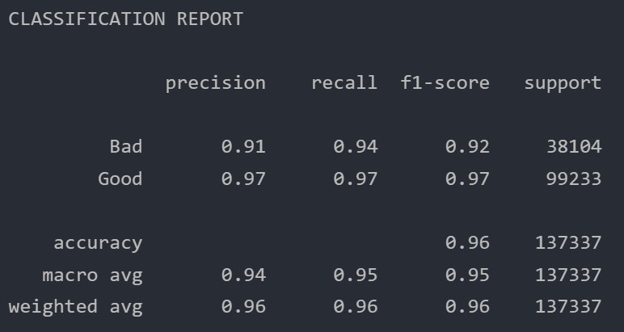
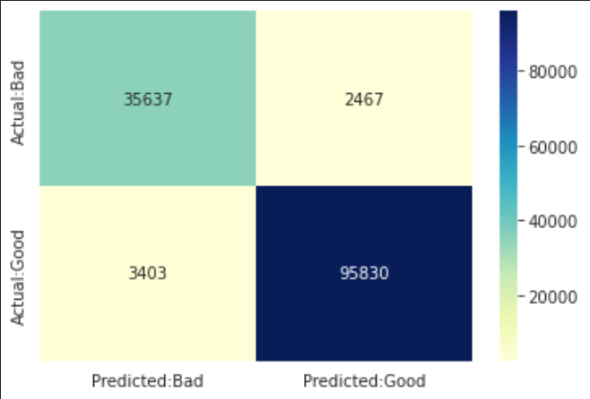
➔MultinomialNB results
Training Accuracy : 0.9741995927273434
Testing Accuracy : 0.957258422712015

Slide 16
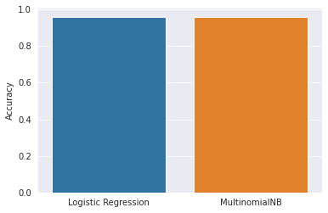
➔ Logistic Regression vs. MultinomialNB

Slide 17
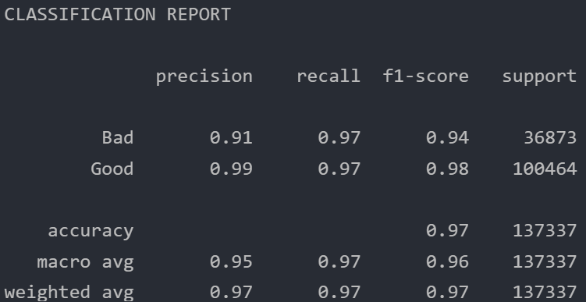
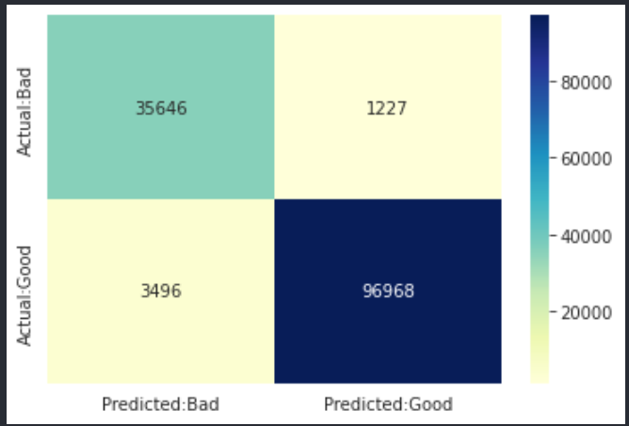
➔Pipelined results
Training Accuracy : 0.9795465633032289
Testing Accuracy : 0.9656101414768052

Slide 18
Limitation and Future Scope
Create Chrome extension which gives you alerts for phishing sites.
In this technique the legitimate URLs are stored in the database and are used for checking new URLs.
Complete the front end of react website

Slide 19
References
https://www.frontiersin.org/articles/10.3389/fcomp.2021.563060/full
https://www.researchgate.net/publication/226420039_Detection_of_Phishing_Attacks_A_Machine_Learning_Approach
https://www.youtube.com/watch?v=biKDqy-_J1o
https://www.kaggle.com/

Slide 20

Thank You

